Slide 1
PhytosanitARY Meeting
MAPA, ABRASEM, APHIS, ASTA
Brasilia, Brazil
February 21, 22, 2017

Slide 2
Topics/Issues to Cover
Overview of APHIS Regulations for Seed Imports and MAPA Normatives
Normative 52
Normative 16
Normative 4
Sampling/Testing of Small Seed Lots
APHIS ReFreSH Initiative
Phytosanitary Risk reduction Research Project

Slide 3
APHIS Seed Regulatory Structure
Federal Seed Act (FSA)
Q-37

Slide 4
Federal Seed Act
Federal Seed Act
Contaminants
Labeling
Purity

Slide 5
Q37
Q37
Allow entry unless demonstrated risk
Regulates propagative Material
Enter with a phytosanitary certificate

Slide 6
U.S. System and Philosophy Regarding Seed
Seed is generally considered low risk (except for certain seed transmitted pests)
The market place dictates what seed varieties are marketed
  No mandatory variety registration in the U.S.
  Seed performance is regulated according to the label (FSA)
  Poor performing varieties do not compete well in the market place
  Intellectual property protected through PVP and patents
APHIS makes no distinction based on intended use of seed
  Seed lots must only meet phytosanitary import requirements, whether the intend use is for breeding, research, seed increase, seed commercialization
  No distinctions made on size of the seed consignment

Slide 7
U.S. Regulatory Structure for Seeds
Seed that is prohibited entry can still be imported for research purposes
  Import permit required; permit conditions customized based on nature of risk
  High risk seed must enter into Federal quarantine (Beltsville quarantine facility): seed is inspected/tested, grown under quarantine conditions, and progeny seed is released (sometimes into PEQ).
APHIS has special requirements for importation of seed packets (e.g. garden seed packets that are for commercial sale)

Slide 8
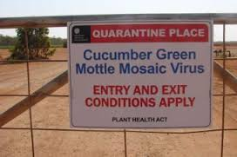
Export Trends
More concern about seed as a pathway
More testing before shipment and upon arrival
Mother plant testing replacing field walks
Interest in developing accreditation systems
8

Slide 9

Concerns About Seed As A Pathway

Slide 10
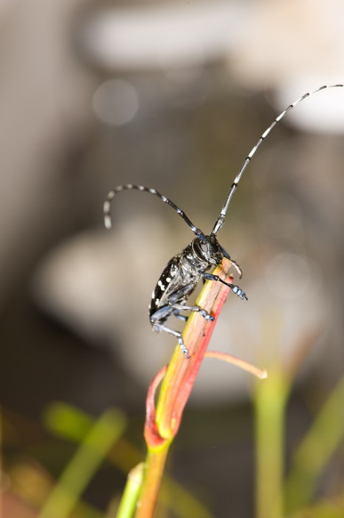
Challenges of Seed Trade
Seed potential pathway for pathogens
Visual inspection not effective at finding pathogens
Seed moves in complex global patterns
NPPOs are all coming up with disparate solutions to the “seed problem”

Slide 11
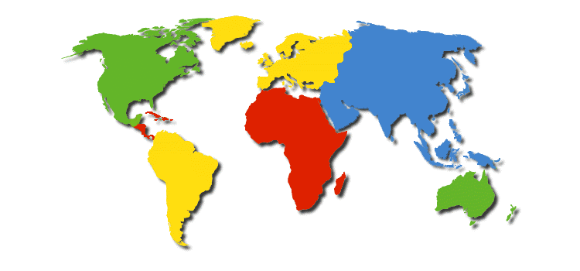
A Complicated Trade Model
3
1
5
6
2
4
7
1.Breeding parental lines: Europe State 1
2.Production of basic seeds: Europe State 2
3. Treatment and manufacture of basic seeds: Europe state 1
4. Production of hybrid seeds: China
5. Treatment and manufacture of commercial seeds: Europe state 1
6. Commercial packaging: USA
7. Final market: Mexico
*Adapted from a presentation by Ric Dunkle, PPQ Seed Summit, 2014
Notes:
Most trade is based on a simple model. One country wants to move their product to a second country. Seed does not adhere to this trade model and the complexity of seed trade presents challenges for regulators who are concerned about maintaining seed free of pests. It is not uncommon for seed to pass through 5 or more countries before it ends up with the final consumer. Seed companies are truly global in nature with research and development, breeder line development, stock seed production, grow out, and post-harvest processing spread around the globe. The trade model represents varying quantities of seeds from a few hundred seeds for a breeder line being developed and tested to container loads full. The diversity of shipment sizes posses problems for seed testing and risk characterization.

Slide 12
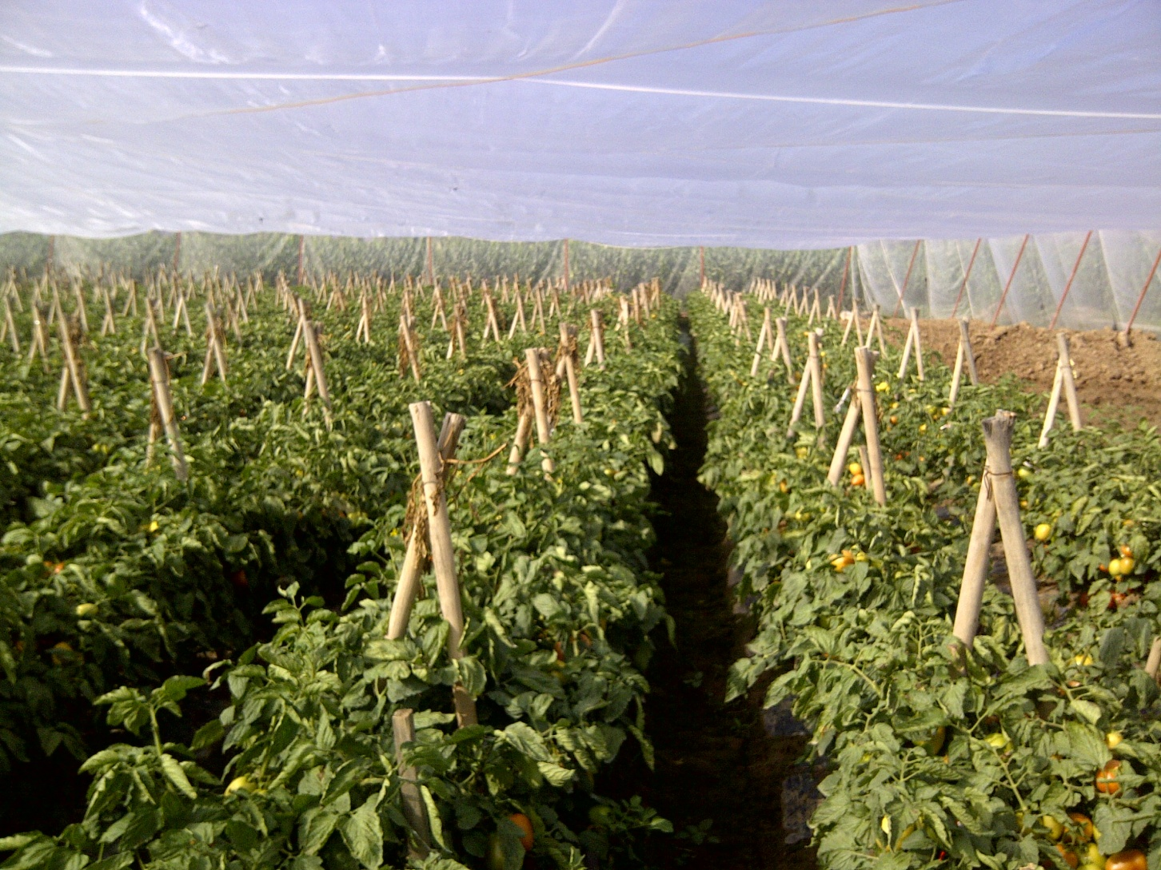
Seed Movement and Exchange

Slide 13
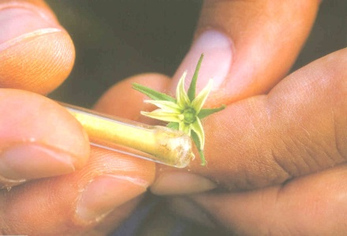
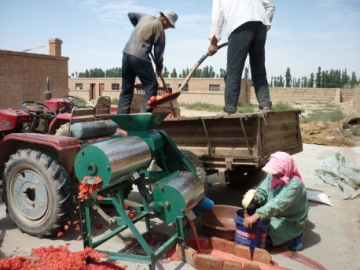
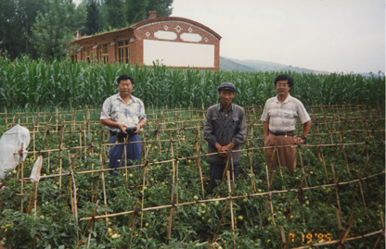
Seed Industry Investments for Developing A More Sustainable Agriculture:
Plant Breeding
Biotechnology
Crop Protection
Precision Ag
Biologicals

Slide 14
The Value of Traded Seed
Exports of Some Selected Countries, 2012 (US$ million)
Africa | Latin America | Asia | Europe | North America
Algeria– 10 | Argentina – 150 | China – 251 | France – 1804 | Canada – 323
Kenya – 9 | Bolivia – 42 | India – 67 | Germany – 727 | USA – 1531
Morocco – 3 | Brazil – 165 | Japan – 145 | Hungary - 385
S Africa – 78 | Chile – 388 | Israel – 126 | Italy – 315
Tanzania – 9 | Mexico – 203 | New Zealand – 111 | Netherlands – 1583
Angola – 8 | Peru – 46 | Thailand – 80 | Denmark – 265
Egypt – 3 | Guatemala – 32 | Australia – 108 | Romania – 218

Slide 15
The Value of Traded Seed
Imports of Some Selected Countries, 2012 (US$ million)
Africa | Latin America | Asia | Europe | North America
Egypt – 53 | Argentina – 95 | China – 268 | France – 687 | Canada – 223
Kenya – 25 | Venezuela – 42 | India – 84 | Germany – 700 | USA – 1312
Morocco – 93 | Brazil – 120 | Japan – 231 | Italy – 422
S Africa – 101 | Chile – 44 | Turkey – 188 | Russian Federation – 373
Tunisia – 12 | Mexico – 355 | S Korea – 111 | Netherlands – 685
Algeria – 26 | Paraguay – 57 | Australia – 113 | Spain – 374
Zambia – 18 | Colombia – 35 | Israel – 49 | UK – 287

Slide 16
Research samples
Research is needed to evaluate products, proving performance and adaptation to local conditions
Value of research seed goes far beyond actual price
  Needs to consider the value of the knowledge and product being developed
Research seed is always limited

Slide 17
Quality Management
Quality concept evolution
  Quality Control
    Quality Assurance
      Quality Management
Seed is an identity preserved business
  Value of the seed is associated with Identity
  Farmers buy clean seed, based on local and internationally recognized purity standards
  Quality Management systems allow industry to manage their business

Slide 18
From Breeding to sales
Each step in the process has to be monitored and traceable
  Assure identity
Quality management required QC at certain points.
  To assure purity, Identity, quality
Diseases testing is commonly included at different stages of seed increases
  Affect productivity, quality and elegibility

Slide 19
From Breeding to sales (2)
In order to develop products, industry has developed global networks, to:
  Assure global and local product adaptation
    Genetics, traits, chemistry, data, etc
  Increase efficiencies, by centralizing certain operations (Production, processing, logistics)
  Increase speed to market, by using global counter season capabilities
Planning and management are essential for success

Slide 20
Brazil Normatives
What are the different normatives in Brazil for seeds and what are their different purposes?
Why is seed for breeding regulated differently than seed for commercial sale?
If a seed species is approved for entry under NI 16, if it is used for breeding, does it fall under NI 52?
What is the difference between NI 16 and NI 4?
What to expect once NI 16 and 52 are enforced: re-testing at POE, how resolve issues at the POEs?

Slide 21
NI-52
New normative provides clarification of the process
The two year permit will be very helpful!
We do not understand the role of SEA/UF in the approval process
The application/approval process appears to be complex and could take many months
  Will likely slow down importation of seed for breeding and therefore slow down breeding programs in Brazil

Slide 22
NI-52
Would MAPA consider a pilot program to find a way to streamline or shorten the approval process? Possible options:
  Exempt certain lower risk seed species (but not from phytosanitary requirements)
  Companies provide periodic reports rather than provide information as a condition of approval
  Modify requirements based on a company’s history/stewardship

Slide 23
NI-16
Major step forward from earlier versions of NI-36!
Country-specific annexes are very helpful: phytosanitary requirements are harmonized for each country involved
Many companies, being global, will be exporting seed from many origins in addition to the U.S.; and this also involves re-export
Still a few concerns regarding specific pests on the U.S. Annex XIV

Slide 24
NI 16:
Evidence of occurrence in Brazil:
  Botryotinia porri
  Peronospora farinosa
  Rhodococcus fascians
  Tomato ringspot virus
  Peronospora viciae
Do Not occur in the U.S.:
  Xanthomonas oryzae pv. oryzae
  Tomato black ring virus
  PSTVd

Slide 25
NI 16:
Seed not a pathway:
  Verticillium nigrescens
  Pseudomonas syringae pv. aptata
  Cercospora insulata
  White clover mosaic virus
  Lentheticus oryzae
  Trogoderma variable
  Typhaea stercorea
  Rhodococcus fasciens

Slide 26
NI 16:
Pathway not proven:
  Botryotinia porri
  Pleospora herbarum (=Stemphylium botryosum)
  Colletotrichum higginsianum (only radish seed sis a pathway)
  Mycocentrospora acerina (only caraway seed is a pathway)
  Balansia oryzae-sativa (only rice seed is a pathway)
  Arabis mosaic virus
  Tomato ringspot virus

Slide 27
N-4
Recent information suggests that phytosanitary requirements for some pests of corn should be reconsidered:
  Cercospora sorghi: evidence that it is widespread in Brazil, not seed transmitted, and any hitch-hiking spores can be mitigated via seed treatment (remove DA 15, enforce DA 5 and DA 2)
  Mycosphaerella zeae-maydis: very limited distribution in the U.S., not detected in the last 20 years, is not seed transmitted, and fungicide seed treatment will mitigate any hitch-hiking spores (remove DA 15, enforce DA 5 and DA 2)

Slide 28
Small Seed lots

Slide 29
Definition of Small Lots of Seed
Lot of seed for which sampling at a recommended phytosanitary (seed health) sample size results in the consumption of all or a significant portion (i.e., greater than 10%) of the lot
  Given that there are different sample sizes per (host X pathogen) combination, the designation as small will vary per crop and pathogen target
  *Note that there is guidance provided in ISPM 31 on small lots and sample sizes; however, these guidelines are not practical.
    E.g., 950 seed sample size for a 1000 seed size lot.

Slide 30
Current Approaches to Regulating Small Seed Lots
Treat small seed lots the same as commercial seed lots: phytosanitary certification
Issue special import permits; state conditions of entry on the permit
Calculate sample size for testing using ISPM 31
Composite sampling of small lots of same seed sp.
If lot size is too small, select an arbitrary percentage of the seed for testing (10%, 20%)
Many NPPOs re-test which further reduces the size of the lot

Slide 31
Are There other Options for Phytosanitary Certification of Small Seed Lots?
Inspection/testing of mother plants rather than the seeds prior to shipment(?)
Produce a generation of seeds in quarantine (at origin or in Brazil), inspect and release progeny seed(?)
Adjust measures to the risk of the seed species(?)
In general, find ways to reduce reliance on seed testing for small seed lots

Slide 32
Testing, Samples sizes, Lot sizes
Host and Pathogen | SAMPLE SIZE FOR TESTING | SMALL LOT SIZE
Xanthomonas on brassicas | 30,000 seeds | 300,000 seeds or less
Pospiviroids on tomato | 3,000 seeds | 30,000 seeds or less
CGMMV on melon | 2,000 seeds | 20,000 seeds or less

Slide 33
Seed Use
Seeds that are imported into the US, generally fall into two categories
  Seed is not planted: Used in controlled environments
    Examples: Disease screens
    Typically samples are kept in lab, GC, GH environments; No fruit production or seed collection performed
  Seed is planted: Used in controlled or open environments
    Seed production
    Trialing
    Commercial fruit production
Seed use bears different risks to US agriculture

Slide 34
If seed is to be planted in new environment, for either line increases or commercial use: SEED TO BE SAMPLED and TESTED
What sample size to use?
  Hypergeometric model is not useful: destruction of high percentage of the lot (ISPM 31)
  Companies may apply a fixed percentage sample to each lot (e.g., 10%)
  GSPP gives an option for a composite sample
    Applicable to cucurbits?
  New approach: Consider the infection unit and set the sample size to permit appropriate detection

Slide 35
Composite Sampling
For small productions there may be only a few hundred seeds available per lot
  Example: breeding lines
    Plants are produced in the same house, area
    Same environment, same handling, etc.
  Composite target: take a sample from each lot, pool into 1 sample (which meets the expected sample size) then test
Pro: Can reach the 2000 seed sample
Con: Logistics. If positive, follow up work is needed to determine which line or lines are positive

Slide 36

Infection Unit Approach
What is an ‘infection unit’?
  It is the smallest ‘unit’ or part of the plant that is in practice uniformly infected
  Some examples:
  The plant could be the infection unit in the case of CGMMV as the disease is systemic (known to spread through the whole plant)
  The fruit could be the infection unit in the case of A. citrulli as the disease is a stem and fruit colonizer (may not have whole plant spread)
* Note: The infection unit approach has been discussed within the International Seed Health Initiative-Vegetables group. The information presented has been taken from sample size proposals shared with other countries as they contemplate approaches to small lots. The ISF logo has been added to reflect the collaborative views between ASTA and ISF (home of ISHI-Veg).

Slide 37
Considerations
If no knowledge on the infection process is available, the smallest possible part of the plant, (e.g. flower, silique, pod, fruit) should be selected as the infection unit
  By determining the smallest part of the plant to be the infection unit, the risk of under-estimating infection in the plant is minimised
  A single infection unit is considered to be the starting point of a disease outbreak during seed production / multiplication. Infection then spreads to other plants

Slide 38
Cucurbitaceae: estimated plant characteristics
Crop | Estimated fruits per plant |  | Estimated seed per fruit |  | Estimated seed per plant
 | Minimum | Maximum | Minimum | Maximum | Minimum | Maximum
Cucumber | 4 | 12 | 25 | 200 | 100 | 2400
Melon | 1 | 2 | 200 | 500 | 200 | 1000
Gourds | 5 | 8 | 25 | 50 | 125 | 400
* Note: According to ISF Cucurbita spp. are susceptible to GGMMV. It has been documented that seed is a pathway for CGMMV in cucumber, melon, watermelon and bottle gourd (Lagenaria).
See also http://www.harrismoran.com/products/cucumber/pdf/CGMMVBrochure.pdf

Slide 39
The statistics
For an infection unit, sample size is calculated using the Binomial distribution* P = 1-(1-r)^{n}, where
P = the probability of detection (POD)
r = the infection rate (i.e. infected seeds in the seed lot divided by the total seed number in the same seed lot)
n = sample size
Sample size is calculated as follows:
n = log (1-P) / log(1-r) Or n = log (B) / log (1-r) where (B=1-P)
* Note: To calculate sample size for small lots a Hypergeometric distribution is often recommended. The Binomial distribution is much simpler to use and sample sizes calculated using the two distributions do not differ very much

Slide 40
Example: Small lots of cucumber
Assumptions
  Infection unit for CGMMV in cucumber: a plant
  A plant produces a minimum of 4 fruits, there are 25 seeds per fruit and all seed in an infected fruit are infected
  A plant produces 2 infected and 2 healthy fruits (so as to account for delayed infections or uninfected seeds).
Additional Notes
  The calculation of sample size doesn’t take into account the spread of the disease between plants resulting in more infected plants and seeds. However, more disease is easier to detect and with greater reliability
  The model requires the number of female plants in a unit of production
  The epidemiological threshold underlying ISTA’s ELISA test for the detection of CGMMV in cucurbit seed provides the upper limit of the sample size which is 2000 seeds
  The technical threshold for detection in ISTA’s ELISA test has been determined at 1 infected seed in 100
Notes:
40

Slide 41
Example: 1 infected cucumber plant;
½ of fruits are infected; total lot is 100 seeds
 |  | Healthy plants | Healthy seeds from infected plant | Infected | Total
 | nr of plants | 0 |  | 1 | 1
 | nr of seeds / fruit | 25 | 25 | 25
 | nr of fruits / plant | 4 | 2 | 2
 | nr of seeds / plant | 100 | 50 | 50
 | TSW | 35.0 | 35.0 | 35.0
 | seed weight per plant | 3.5 | 1.8 | 1.8
 | lot weight (g) | 0.0 | 1.8 | 1.8 | 4
 | lot weight (kg) | 0.0 | 0.0 | 0.0 | 0.00
 | nr of seeds produced | 0 | 50 | 50 | 100
 | infection rate | 0.5000
 | Minimum infection unit model
 | When probabillity is 95% (= B=1-P = 1-0.95)
 | Probabillity of detection (P) | 0.95
 | n = Log B/ log (1-r) | 4 | seeds to be tested
 | # seeds tested per plant | 4.3
 | Percentage of seed lot | 4.322%

Slide 42
Example: 10 melons, 1 infected plant, ½ of the fruit are infected; total lot is 4000 seeds
 |  | Healthy plants | Healthy seeds from infected plant | Infected | Total
 | nr of plants | 9 |  | 1 | 10
 | nr of seeds / fruit | 200 | 200 | 200
 | nr of fruits / plant | 2 | 1 | 1
 | nr of seeds / plant | 400 | 200 | 200
 | TSW | 35.0 | 35.0 | 35.0
 | seed weight per plant | 14.0 | 7.0 | 7.0
 | lot weight (g) | 126.0 | 7.0 | 7.0 | 140
 | lot weight (kg) | 0.1 | 0.0 | 0.0 | 0.14
 | nr of seeds produced | 3,600 | 200 | 200 | 4,000
 | infection rate | 0.0500
 | Minimum infection unit model
 | When probabillity is 95% (= B=1-P = 1-0.95)
 | Probabillity of detection (P) | 0.95
 | n = Log B/ log (1-r) | 58 | seeds to be tested
 | # seeds tested per plant | 5.8
 | Percentage of seed lot | 1.460%

Slide 43
A proposal for sampling small lots of cucurbit seed
Based on the model
A sample size of 5% is calculated for the smallest cucumber lot.
This can also be used for other cucurbit seed given that cucumber has the lowest infection rate (more fruits) as compared to other cucurbit crops
It is possible to ‘pool’ samples from many small productions as one infected seed will be present in a sample with 95% probability
When all seeds in the pooled sample are tested, the size of the pooled sample is irrelevant provided they are tested in subsamples of 100 seeds
Note: The calculation demonstrated by the model and explained in this presentation is only valid for CGMMV
Notes:
43

Slide 44
Small Seed Lots: Next Steps
APHIS is using the “infection unit” concept in the NSHAPP pilot program for sampling small seed lots for CGMMV testing
ISF statisticians have determined that the infection unit concept is statistically valid
ISHI-Veg is testing out the concept on CGMMV-infected seed
  Comparative study (hypergeometric sampling vs. infection unit sampling)

Slide 45
Small Seed Lots: Next Steps (2)
ASTA is considering supporting a new research effort (Iowa State University) on validating the infection unit concept in close coordination with the ISF ISHI-Veg program.

Slide 46
Regulatory Framework for Seed Health: A partnership project between APHIS and ASTA
Angela McMellen Brannigan
Seed Health Coordinator

Slide 47
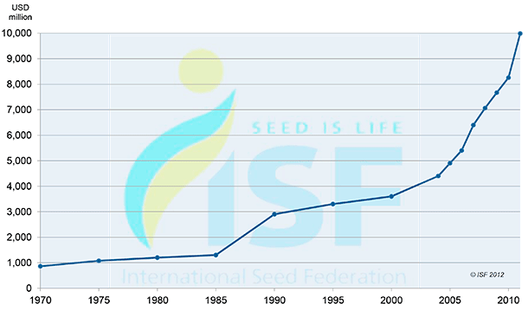
Forty Years of Seed Trade
47

Slide 48
A Complicated Trade Model
3
1
5
6
2
4
7
1.Breeding parental lines: Europe State 1
2.Production of basic seeds: Europe State 2
3. Treatment and manufacture of basic seeds: Europe state 1
4. Production of hybrid seeds: China
5. Treatment and manufacture of commercial seeds: Europe state 1
6. Commercial packaging: USA
7. Final market: Mexico
*Adapted from a presentation by Ric Dunkle, PPQ Seed Summit, 2014
Notes:
Most trade is based on a simple model. One country wants to move their product to a second country. Seed does not adhere to this trade model and the complexity of seed trade presents challenges for regulators who are concerned about maintaining seed free of pests. It is not uncommon for seed to pass through 5 or more countries before it ends up with the final consumer. Seed companies are truly global in nature with research and development, breeder line development, stock seed production, grow out, and post-harvest processing spread around the globe. The trade model represents varying quantities of seeds from a few hundred seeds for a breeder line being developed and tested to container loads full. The diversity of shipment sizes posses problems for seed testing and risk characterization.

Slide 49
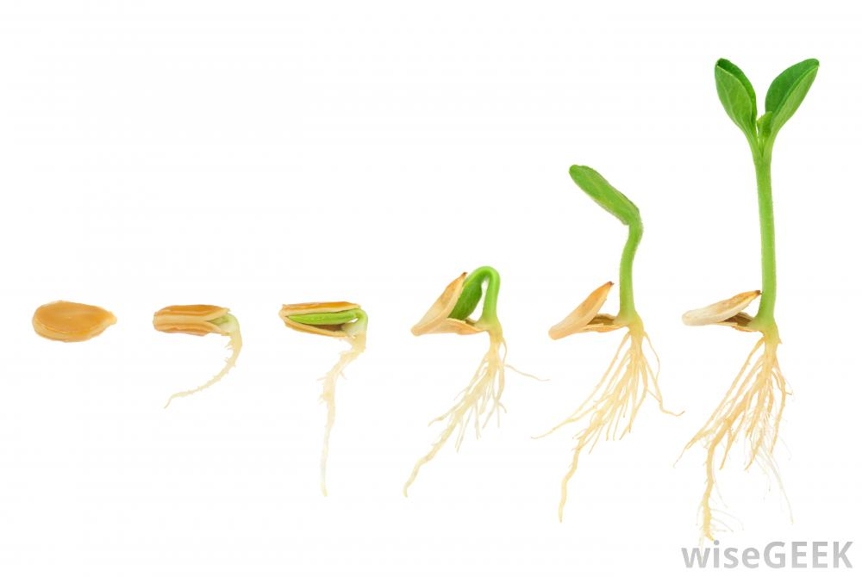
National Seed Health Accreditation Pilot Program (NSHAPP)
APHIS’ Pilot for Imported Seed

Slide 50
What is NSHAPP?
National Seed Health Accreditation Pilot Program (NSHAPP)
Testing a new model for mitigating risk of imported seed
Coordinated effort between the Iowa State University and APHIS
Industry participants voluntarily self-test imported seed and report results to APHIS
Initial target – CGMMV in cucumbers, melons, watermelon
Notes:
APHIS does not currently have the infrastructure to test seed at the port of entry so we are looking at different models. One model currently being tested is having companies test at accredited laboratories upon entry into the U.S. but before the seed is distributed for sale. The labs have to be accredited either through NSHS or Naktuinbouw.

Slide 51
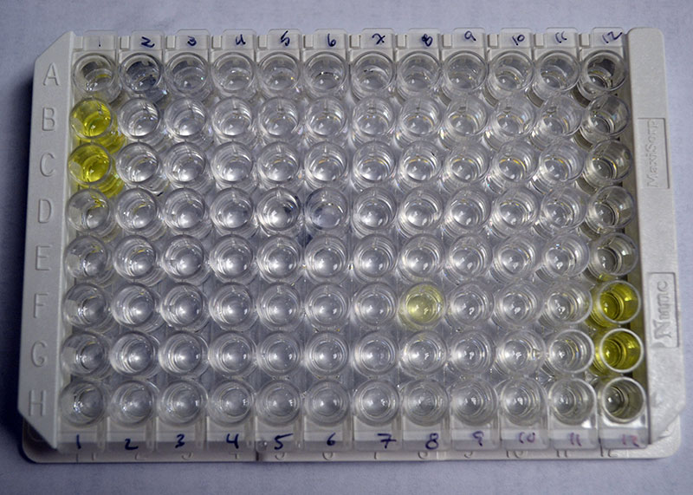
NSHAPP Summary
Seven enrolled companies
Eight positive lots (India and China)
4,412 lots tested as of January 1

Slide 52
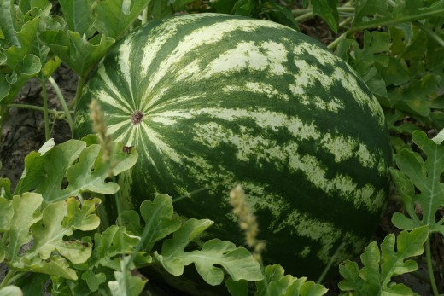
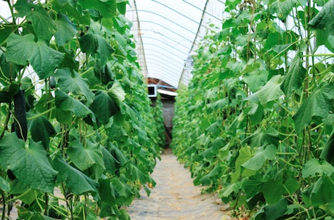
NSHAPP Successes
Detected and destroyed positive seed lots
Increased collaboration with industry
Increased knowledge of seed business models within APHIS
Creating ideas for future seed work

Slide 53
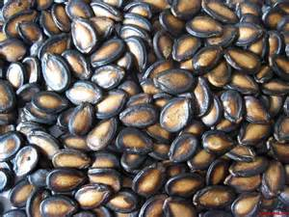
NSHAPP Challenges
Encouraging industry participation
  What is the incentive to participate?
Working within the different business models of the participating companies
Focus is only on seed testing

Slide 54
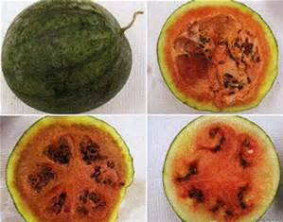
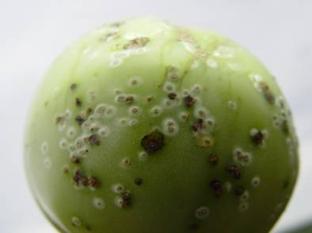
How do we mitigate the seed pathway?
Notes:
The U.S. had a couple cases of CGMMV pop up in fields in California. This raised the profile of seed transmitted diseases within APHIS and caused us to consider a different approach to seed imports.

Slide 55
Potential Models Considered
NAPPRA (Not Allowed Pending PRA) and NSHAPP
Citrus Nursery Stock Protocol
EC Nursery Passport
Seed Industry Best Management Practices
ISPM 15
SANC (Systems Approach to Nursery Certification)
USGCP/USNCP (US Greenhouse Certification Program/US Nursery Certification Program)

Slide 56
Commonalities of Systems Considered
Start clean and stay clean
Document systems to maintain integrity of crop
Using testing to verify system integrity
Complicated movement patterns

Slide 57
International Interest in Seeds
Recent increase in number of requirements and regulations from other countries
Ongoing work to develop an international seed movement standard
Seed treatment project in NAPPO
Opportunity for PPQ and Seed Industry
Notes:
Like many other countries who are facing similar challenges, we are grappling with how best to facilitate the safe, uninterrupted movement of seed while protecting US agriculture from seed-borne disease risks.
Today, we’re seeing the emergence of numerous regulations and requirements from different countries, including Brazil, Chile, the European Union, Russia, and Australia.
It seems that everyone is trying to come up with something new to regulate seed trade and help mitigate the risk of seed-borne disease.
In addition, the IPPC is also working on a draft standard for seed movement.
In my opinion, the time is ripe for someone to step forward and lead a global dialog on seed trade and seed transmitted diseases.
I believe that PPQ is well-positioned, working with you, the seed industry, to lead that conversation.

Slide 58

Regulatory Framework for Seed Health
ReFreSH

Slide 59
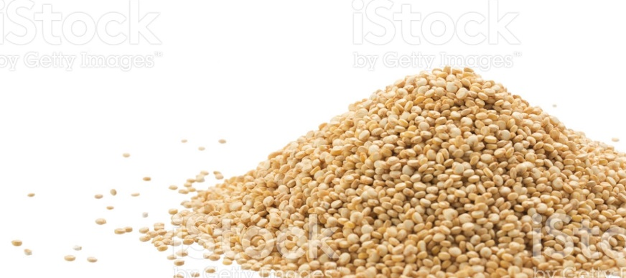
A New Approach
Regulatory Framework for Seed Health (ReFreSH)
Risk-, science-based systems approach
Work within current seed trade model
Leverage industry best practices
Promote global adoption
of seed trade framework

Slide 60
ReFreSH-Clean Seed “Passport”
Participating company will be issued a clean seed document
Production process will be certified/accredited at each stage
Industry required to report pests
Goal: Facilitate safer global movement of clean seed

Slide 61
ReFreSH
Clean Source Material
Test to verify and/or inspect mother plants
Identify priority commodity/pest combinations
Breeder
Lines
Safeguard and inspect/test progeny
Focus on safeguarding because testing not practical
Grow Out
Use clean production practices
Develop system that can be used in various locations

Slide 62
ReFreSH
Increase Seed
Field inspection, test
Best management practices
Harvest Seed
Maintain identity
Safeguard against pest incursions
Post-harvest
Maintain identity
Safeguard against pest incursions

Slide 63
Developing the Framework: ReFreSH Workshop, January 27, 2017
Understand current industry practices
  Pest management
  Post-harvest processing
  Quality management
Evaluate risk
Determine available risk mitigation tools
Identify gaps
Industry collaboration is critical.
Notes:
The most critical factor for this program’s success is industry participation. We not only need your input, but also your collaboration to help shape and influence the development of a system that makes sense from both an industry and a regulatory perspective.
Our first step is to gather information about the seed production process and industry practices to help inform the development of the approach.
Concurrently, we need to evaluate the risks associated with seed trade, identify critical production points, determine available risk mitigation activities, and identify gaps that needs to be addressed through research and methods development to expand our regulatory toolbox.
Our goal, working with you, is to develop certification and accreditation standards that will allow us to know at each stage of the seed production and trade process what needs to be done to effectively mitigate risk.
We have an enormous opportunity ahead of us, and a tremendous amount of work.
We need to build consensus—domestically and internationally—about how seed should be handled as we work to develop a practical system that can accommodate how seed moves around the world.
I look forward to working with you to develop a framework that would not only promote safer, more predictable seed trade, but also ensure a steady and reliable source of safe American seed for consumers here and around the world.

Slide 64
Information Needs
Seed production practices
Global production areas and typical movement patterns
Pests of high concern
Differences between small and large producers
64

Slide 65
Information Sharing Between APHIS and Industry
How can industry be comfortable sharing information?
Confidentiality agreements?
One on one meetings?
Joint APHIS/ASTA working groups to develop the framework
65

Slide 66
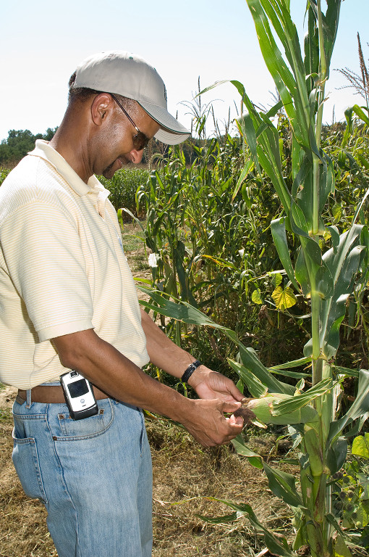
Risk Characterization
Pathway analysis
Pest risk assessment of high profile crops
Determine critical quarantine pests that follow the pathway

Slide 67
Technical Needs
Develop validated testing methods for pathogens of concern
Resolve sampling question
What do we do with small lots of seeds?
67

Slide 68
Accreditation Standards
Document and evaluate production practices
Evaluate current best management practices
  What can we build on?
Identify key risk management points in production and post-harvest processing
Develop standards for production and post-harvest processing and storage
68

Slide 69
Leading a Global Conversation
APHIS is working with other NPPOs to establish widely accepted global seed movement system that promotes a managed risk approach
APHIS has had initial conversations with QUADs countries and Netherlands
Initial discussions for an international NPPO meeting this year on seeds

Slide 70
Encouraging Industry Participation
High industry participation key to success
What can we do to encourage industry to participate?
70

Slide 71
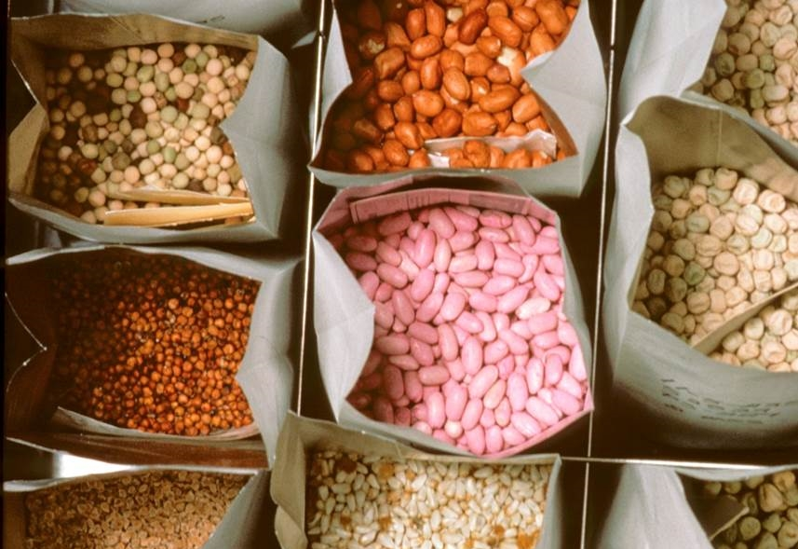
Benefits of a Seed Health Framework
More predictable, technically justified requirements
Faster and easier movement of seeds
Lower risk of seed transmitted disease
Notes:
If successfully implemented, ReFreSH would increase the safety of global seed trade and reduce the risk of seed transmitted diseases.
It would also establish predictable, technically justified requirements that would allow for faster, easier movement of seeds.

Slide 72
Collaborative Effort to Build Global System
APHIS
Industry
Foreign NPPOs
Notes:
If successfully implemented, ReFreSH would increase the safety of global seed trade and reduce the risk of seed transmitted diseases.
It would also establish predictable, technically justified requirements that would allow for faster, easier movement of seeds.

Slide 73
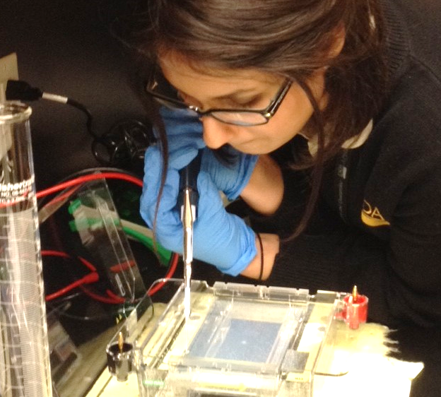
Challenges of New Model
How do we develop a truly global seed trade regulatory system?
How do we as an NPPO setup a system outside of our control?
How will we build a system based on trust, but with verification built in?
What role will molecular diagnostics play?
The Impact of Molecular Diagnostics: A Catch 22?
Greater ability to detect, identify pathogens and safeguard agriculture
Application of technology to regulatory problem resolution is not straight-forward

Slide 74
ReFreSH Contacts
APHIS: Angela McMellen-Brannigan
Email: angela.mcmellen-brannigan@aphis.usda.gov
Phone 1-301-851-2314
Industry: Ric Dunkle
Email: rdunkle@betterseed.org
Phone 1 703-226-9275

Slide 75
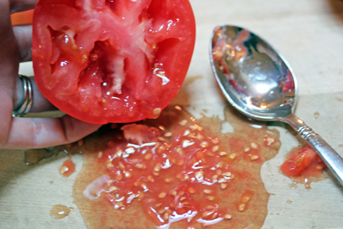
Effects of Seed Quality Management Practices on Phytosanitary Risk Reduction
José Laborde (Postdoc - Biostatistics) NCSU-CIPM/USDA-ARS
Stephen Ippolito (Postdoc - Mathematics) ASTA/USDA-ARS
Gary Munkvold (Professor and Chair, Seed Technology & Business Graduate Program) ISU
Alissa Kriss (Math-Stats-Pathology Consultant - Liaison) Syngenta
Tim Gottwald (Epidemiologist/Research Leader) USDA-ARS
2017

Slide 76
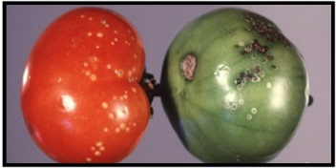
Goal
“To develop a probabilistic risk-based model to assess the efficacy of seed quality management practices in reducing phytosanitary risks as well as enhancing disease control”
Initially, the main focus is CMM (Clavibacter michiganensis subsp. Michiganensis) as a model system.
Photo: http://www.posgradoeinvestigacion.uadec.mx/CienciaCierta/CC33/1.html#.VmnjBk2FNaQ

Slide 77
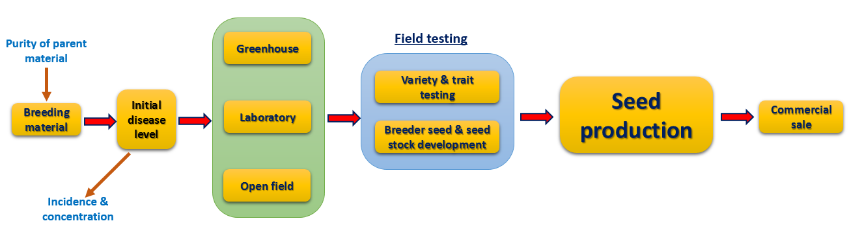
Motivation for our modeling approach
Module 1
Module 2 - 4
Module 5 & 6
Module 7
Module 8
The seed goes through a pathway which has several components.
Some components introduce risk and some others are mitigation measures of that risk.
Each component may have different outcomes associated with a probability.
Not every component can readily generate data to populate a model.
Hence, this problem can not be solved by simple data collection and later performing logistic regression since not every covariate is or can be measured.

Slide 78

Our Approach: Causal Reasoning
The seed pathway appears to be best described by a model where the collection of variables each represent either a risk-mitigation or a risk-introducing factor in the production process, and there is dependency relationships among them.
In causal reasoning we assume that the variables share a cause and effect relationship explicitly.

Slide 79
Our approach: A Bayesian Belief Network Model
Nodes Connected with directed edges:
  Node: Random Variable
  Edge: Dependency relation between Nodes
Parent Node
Child Node
$$P\left(Bayesian Network\right)=P\left(Parent,Child\right)=P(Parent)P(Child|Parent)$$

Slide 80
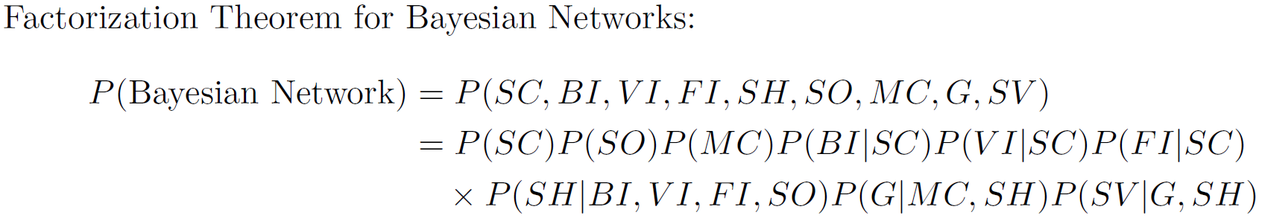
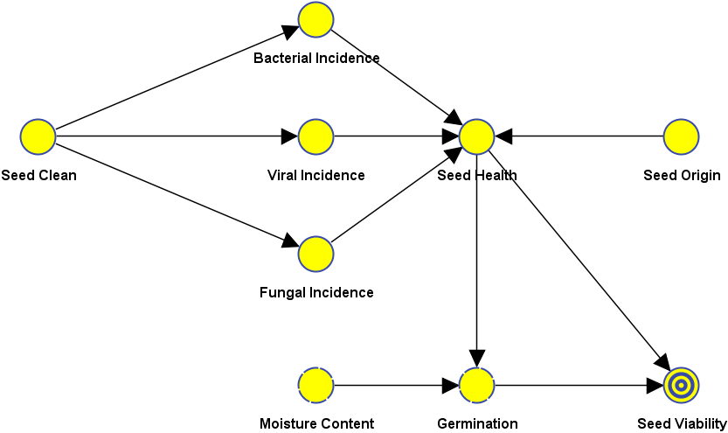
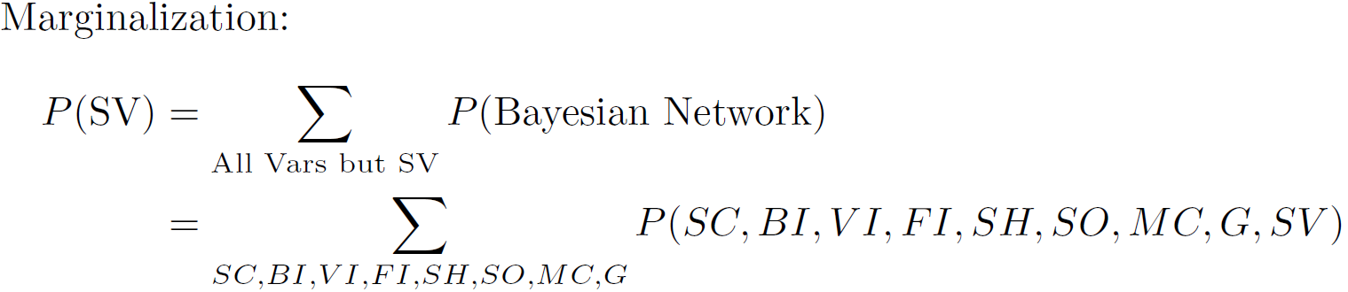
From Graph to Marginal Probability

Slide 81
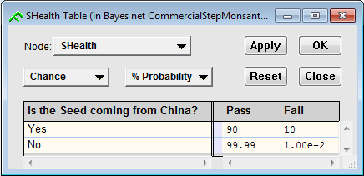
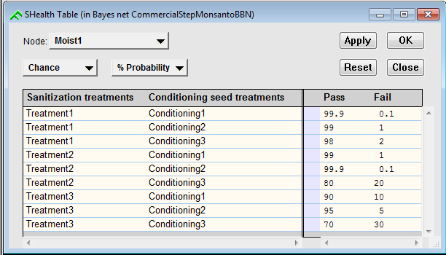

Conditional Probability Tables
$$P(SeedHealth|FromChina)$$
$$P(MoitstureContent|Sanit.Treatments, Cond. Treatments)$$

Slide 82
Tasks
Capture unaccounted nodes comprising the structure to improve the initial model.
Learn/propose a network structure of the improved model.
Gather data to populate CPTs (Conditional Probability Tables) where possible.
Elicit expert’s probabilities for parameters on CPTs where data is unavailable

Slide 83
The Plan
Design of a specific plan to refine and populate our current model through expert panels and data collection.
Plan consists in 4 rounds of consultation.
  The first 2 rounds are phone interviews with experts on different aspects of the seed process,
  the third is a joint meeting with all the stakeholders involved in the interviews to present and agree on the model,
  and the 4th round deals with data collection and expert opinion elicitation where necessary.

Slide 84
Plan for BBN:
4 rounds of consultation 3 of which are meant for the first so called model design panel and the last one will include the second so called expert elicitation panel.
Round 1: Initial round of consultations with the stakeholders via one-on-one interviews. The purpose of this round is to clarify their views when presented with the project’s objective. This refined our current model.

Slide 85
Round 2
Round 2: conducted to discuss modifications of the model that where based off the results from Round 1. This includes:
  Checking validity of relationships deduced from round 1.
  Define States for each Node in the BBN.

Slide 86
Rounds 3 and 4
Round 3: Consist in a joint stakeholder workshop to discuss differences in viewpoints. After this workshop the model’s design should be complete.
Round 4: Data collection. The sources of data could be:
  Raw data collected by direct measurement (either observational or experimental).
  Output from process-based models calibrated using raw data collected by direct measurement (this type of data might be rare in this case since it will be the result of e.g. a regression model fitted to some data from a specific process)
  Expert opinion based on theoretical calculation or best judgement.

Slide 87
…Round 4
Our previous consultations will enable us to determine which nodes in the BBN will require which type of data (or have no choice but to use a certain type).
The very last type of data will require a customized survey which will be sent to the appropriate experts. These will be based of the sub BBN nodes (given by each expert opinions to be elicited).

Slide 88
First round
We acquired a significant amount of information detailing the most important aspects of the seed process with respect to the objective of the study.
Panelist | Expertise 1 | Expertise 2 | Company | Interview Date
Panelist 1 | Distribution/Sales | Regulatory | Company 1 | 7/20/2016
Panelist 2 | Field Ops | Phytopathology | Company 2 | 7/29/2016
Panelist 3 | Regulatory | Trade | Company 2 | 8/4/2016
Panelist 4 | Seed Health Testing | Phytopathology | Company 3 | 8/5/2016
Panelist 5 | Plant Ops | Field Ops | Company 4 | 8/8/2016
Panelist 6 | Phytopathology | Seed Health Testing | Company 2 | 8/10/2016
Panelist 7 | Seed Health Testing | Regulatory | Company 5 | 8/16/2016
Panelist 8 | Field Ops | Greenhouse Ops | Company 6 | 8/26/2016
Panelist 9 | Greenhouse Ops | Field Ops | Company 7 | 8/29/2016
Panelist 10 | Phytopathology | Seed Health Testing | Company 4 | 8/30/2016
Panelist 11 | Seed Health Testing | Phytopathology | Company 1 | 8/31/2016
Panelist 12 | Distribution/Sales | Seed Health Testing | Company 8 | 9/8/2016

Slide 89
…First round
After the round ended we proceeded to analyze the information gathered and spent time deducing the structure of the Bayesian Network implied by the panelists.
The modeling team approved this structure and after minor adjustments it will was used to generate the questions needed for the second round.

Slide 90
2nd round
Necessary to adjust labels for variables and their outcomes.
Model structure was not discussed with panelists, only the model’s variables.
Performed with fewer panelists than those from 1st round.
Most crucial aspect of the study has been achieved and the remaining aspects deals with label adjustments and data collection to fill in the Conditional Probability Tables needed to populate the model.
The labeling is important since it deals with variable definitions and the correct language to be able to produce appropriate data for model population.

Slide 91
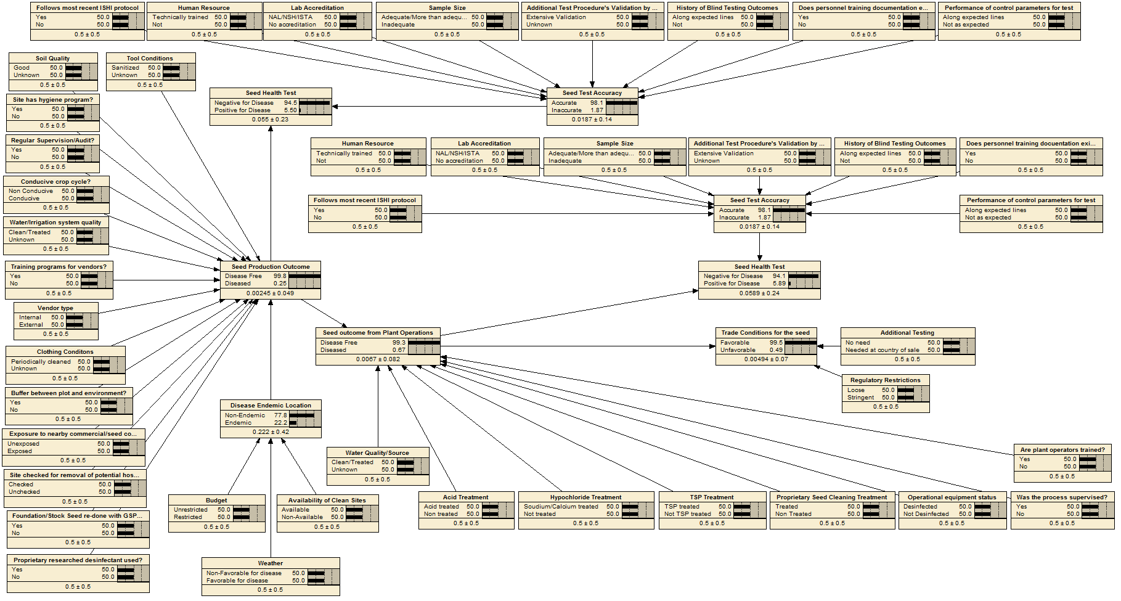
Resulting Model:

Slide 92
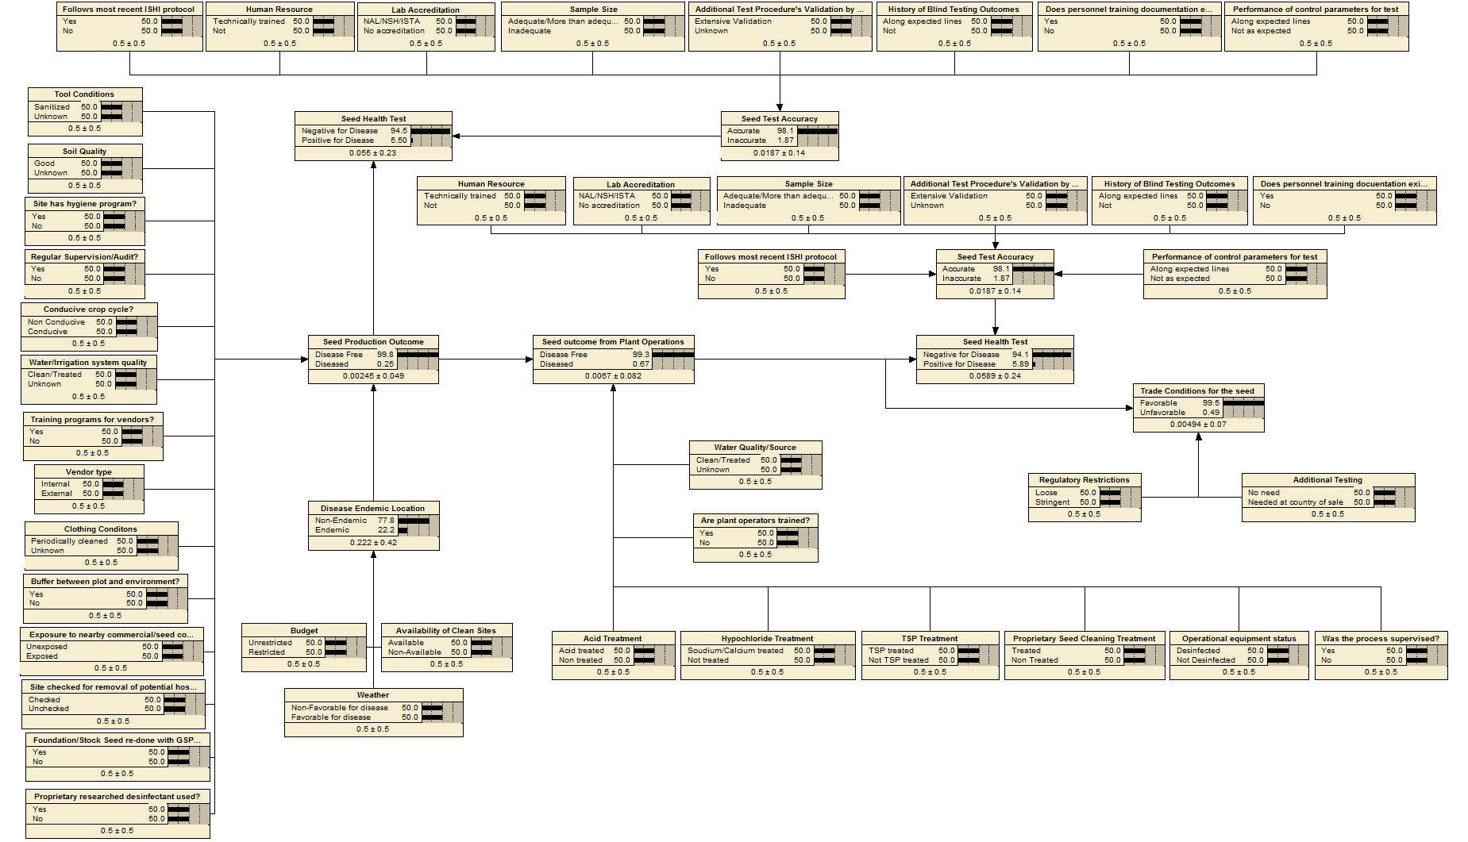
An equivalent version:

Slide 93
Groups of variables (lab testing):

Slide 94
Groups of variables (field ops):

Slide 95
Groups of variables (plant ops):

Slide 96
Groups of variables (trade):

Slide 97
Groups of variables (Disease Endemnicity):

Slide 98
Observations:
The model has generalization potential: only some adjustments will be required to describe any combination of pathogens and seed type.
Model allows to give partial knowledge to give predictions: as seen in the example we did not need to “activate” every evidence node to be able to obtain a prediction of the target variables.
The expert elicited CPTs can be updated with real data as time progresses since the use of the model compared with real life outcomes will provide a rich source of information in a very structured fashion.

Slide 99
Data anyone?
Time for the last round!

Slide 100
Questions & Answers

